Slide 1

Founded by Jeff Bezos
Launched 1993
A fast paced web-base online retail store

Slide 2

Change Intervention
Change in EthicalDiversity
Change in Culture
Notes:
Amazon is in dire need of change. The need for change in the culture of the workplace as well as diversity in leadership positions. The recent unrest of change interventions within the entire country has sparked the attention of people wanting to see cultures change their mindset when it comes to workplace acknowledgments and hiring practices. Amazon has a culture issue because of their lack of hiring of African American females and giving opportunity for leadership positions. In a www.cnbc,2019 article it listed only four of 48 executives at Amazon is female. This needs a change invention. The ethical diversity exist because the woman are outnumbered at Amazon, only one African American. This is not acceptable for an organization that has so many employees. The diversity needed at Amazon will show how the organization embrace culture and other ethical backgrounds will bring the organization into the next century of leadership.

Slide 3

Steps for Change
Consultation for Change Intervention
Meeting with CEO, and Leadership Team
Brainstorming Session with Leadership
Proposal draft presentation to CEO
Notes:
There are steps to be presented to CEO, Jeff Bezos to show needed changes requesting for an outside consultation with a professional consultant. The professional consultant will be given the task of convincing the CEO of needed changes. The meeting to discuss the change intervention will first include the CEO. The next meeting will include the leadership team with the consultant who will provide statistical data to show the need for culture and diversity changes within the Amazon organization. The brainstorming session will be conducted to provide the CEO and staff an opportunity to voice opinions of how the change intervention will be implemented. The need to brainstorm will be to get the input of “the development of change leadership and employee commitment to change” (Ling, eta, 2018). Organizational change relies on an effective leadership. The leadership team has to show they are in for the change intervention to get other staff involved with the process.

Slide 4
Department Leadership
Plan Implement Manage
Notes:
In planning there has to be a need for department leadership to get involved in the planning stage of change intervention. The change has to include the implementation of change showing leadership is on board for the implantation of change. The change has to be managed by leadership. The leadership has to know the culture of the organization to properly implement to appropriate needed change. Knowing the culture of the organization will allow the leadership team to advise the consultant of needed considerations for the implementation of change. In Lauren, eta, 2020, the author attributes the “implementation of an innovation in an organization require that employees attend training sessions, and available resource sessions. The topline employee’s or leadership has to show the other employees they are engaged and willing to change the behaviors of leadership to implement a change intervention needed for the success of the organization is very important.

Slide 5

Skills and Principles
Define
Measure
Analze
Design
Validate
Notes:
The six sigma process attributed to success include define, measure, analyze, design, and validate according to a study conducted by Lee, Kim, Lee, eta, 2019. The study preformed insist the need for creative problem solving is key to a successful implementation of change. The needed skills and principles for a change intervention include having a defined project for change. The need to use measurements for success, and analyze the performance of change, while designing a change intervention to meet the needs of change. The final stage would be to validate leadership is on track for implementing the change intervention. The leaders in the organization is the driving force for a positive change intervention because they have the knowledge of the culture the organization is dealing with.

Slide 6

Change
Notes:
The change timing is to change in phases of four quarters, giving a one year timeframe, allowing a six month grace period to account for delays in the change interventions implementation. The timing of a change intervention is to allow the consultant, CEO, leaders, and staff a chance to give their input prior to the launch of the change intervention. The staff is most important because they are the change engines that have to change their culture and environment to accommodate a change within the organization for the success of the organization. The phases have to be monitored for implementation of the next phase transition. The next phase has to be signed off by the leadership to get the go ahead for the next phase. In between the phases there has to be meeting giving out words of encouragement to staff embracing their willingness to make for a successful organization.

Slide 7

Change Team
CEO, Jeff Bezos
Consultant
Leadership
Staff
Notes:
In organizational change intervention there has to be a team of people involved and engaged to make the change happen. The Amazon change team will consist of first the CEO, Jeff Bezos who will initiate the change proposal and hire the consultant for assistance. The leadership team will be directed to gather information about the culture within the organization. The culture information will be given to the consultant to draft a propose plan of action for change. In an article “Built to Change” the author insist that first there needs to be a examination of the organizations identity. This statement is very powerful indicating the identity that the organization has is the start of knowing what changes are need for a successful change intervention. The identity of a person is valuable in accessing their behaviors, this holds true to the organizations employees image displayed in the workplace. The identity is how others will identify if change has occurred.

Slide 8

Barriers of Change
Unwanted Behavior
Interruption of Power
Transference
Notes:
The unwanted behavior of organizational staff is a very alarming truth to change. The triggers of staff can be the walls of destruction for other. The organization will encounter barriers because the change involves people. The mind of people can be challenging and difficult to manage when change is on the table. The interruption of power can cause for the unwanted barrier for a successful change intervention. The need for the leader to take charge will cause for a barrier to be put up in the change intervention. The leader must show the willingness to be on board with the change intervention for the success of the organization. In Carucci, 2016 the author attributes “failures continues to be more common than success”. This statement implies that the barriers will be more common in the change intervention than the success of the change intervention. The failures of change are common because the people aspect of behaviors.

Slide 9


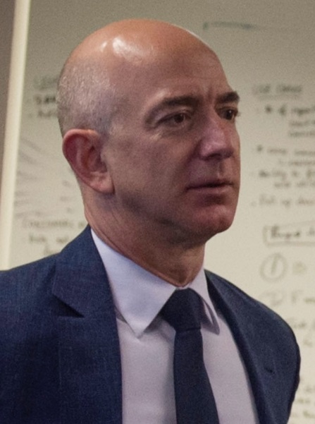
Bridge the Gap of leadership allowing African American woman a seat at the table of leadership
Summary
Notes:
Amazon’s CEO, Jeff Bezos is pictured shaking hands in agreement with an African American potential leader. The handshake is identified showing the leadership is onboard for a change intervention in Amazon. The picture eludes to show how the leader of a multi million dollar organization can show he agrees with the needed change intervention to show his employees that change is coming. The Amazon brand is highly recognized by all because of its logo. Zuniga, attributes “African American Consumers’ Evaluation of Ethically Primed Advertisement” as the most important element of marketing. The marketing of change showing consumers and staff of your intent through advertisement is more powerful than words. The Amazon brand is in need of a change intervention showing its consumers change is on the rise and Amazon will a part of the change means a lot to people spending their hard earned money with a brand that dose not embrace change can have a failed intervention.

Slide 10
References
WWW.cnc.com https://www.cnbc.com/2019/01/23/who-are-amazons-top-executives-2019.html
Hirsch, P. B. (2017). The charge of the white brigade. The Journal of Business Strategy, 38(1), 47-50. doi:http://dx.doi.org.proxy-library.ashford.edu/10.1108/JBS-10-2016-0131
Kotter, J.P. (2008). A sense of urgency. Boston, MA: Harvard Business School Publishing.
Zúñiga, M. A. (2016). African American Consumers’ Evaluations of Ethnically Primed Advertisements. Journal of Advertising, 45(1), 94–101. https://doi-org.proxy-library.ashford.edu/10.1080/00913367.2015.1083919

